Slide 1
Professional Financial Reports with {rmarkdown}
Brad Lindblad, MBA
bradley.lindblad@gmail.com
Technistema.com
Repo:
https://github.com/bradlindblad/pro_reports_talk

Slide 2




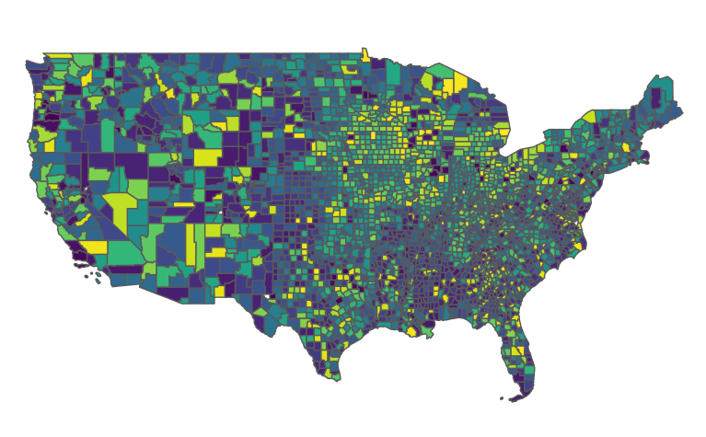
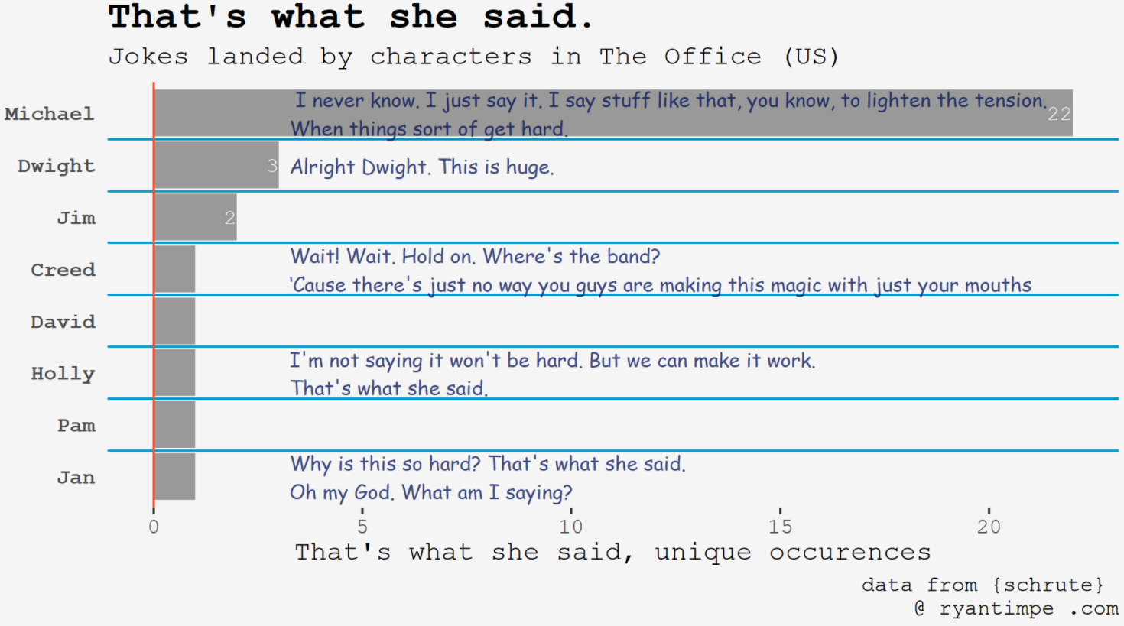
About me
@ryantimpe

Slide 3
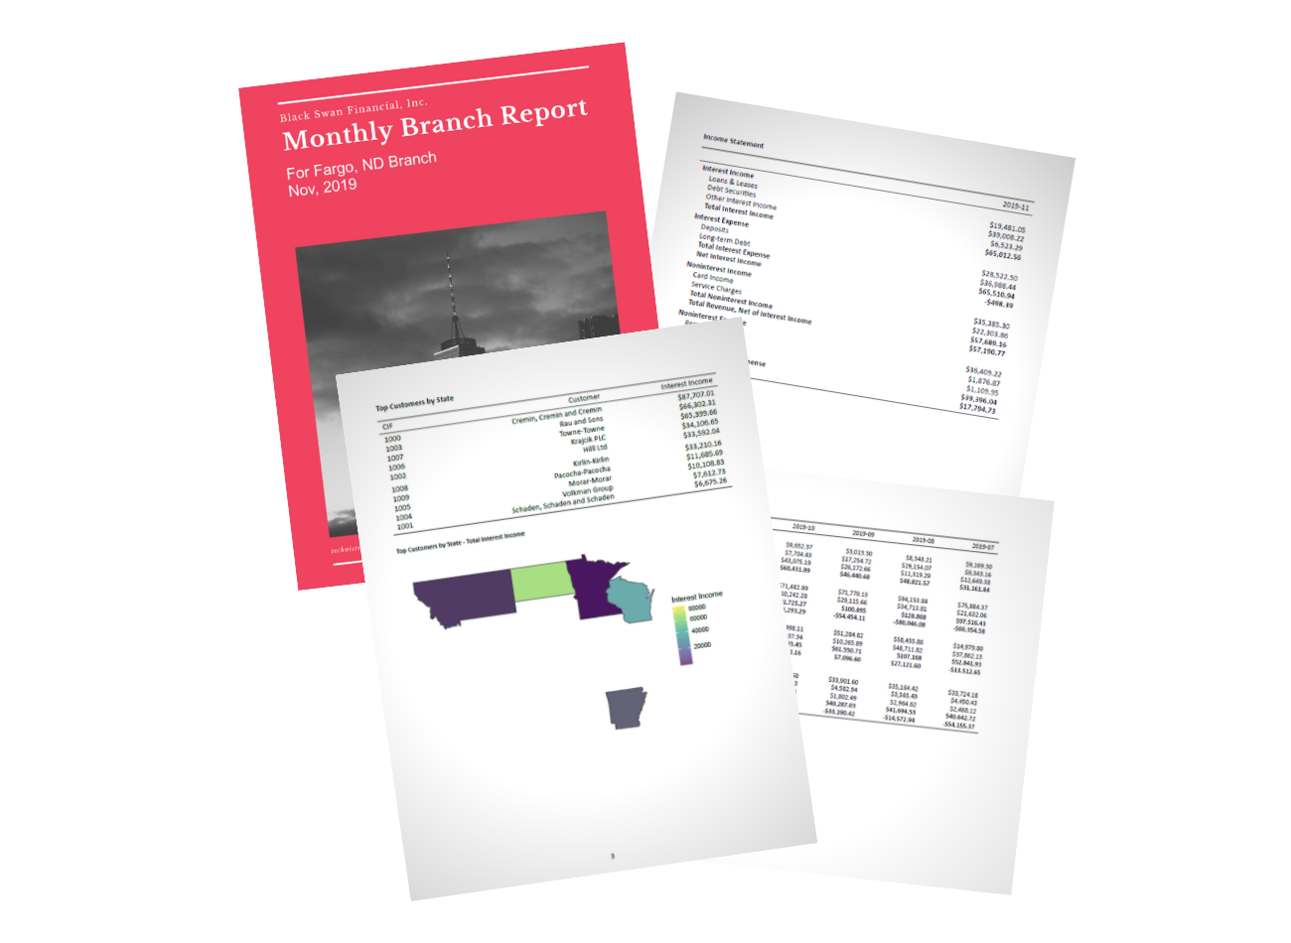

Slide 4




Key players

Slide 5
Disclaimers:
Rmarkdown / pandoc / TeX can cause pain
Use {renv} : > renv::restore()
Potentially, > tinytex::reinstall_tinytex()
More troubleshooting at the Github README
Tested on:
Windows 10
Linux Mint 20 (may need to install magick++ with apt)
Mac OS

Slide 6
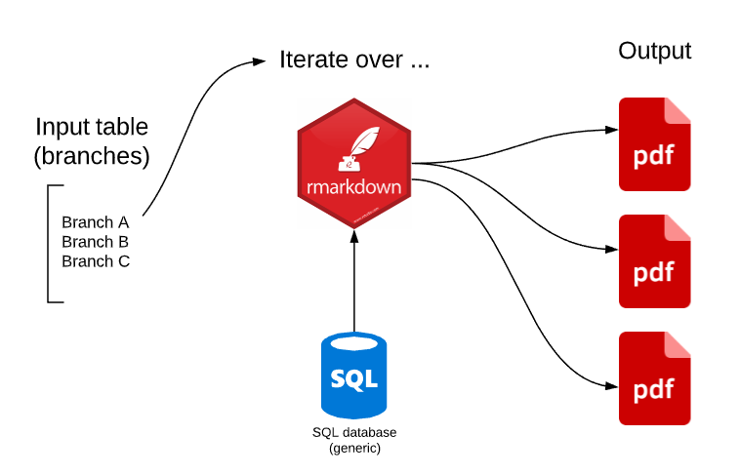

Slide 7
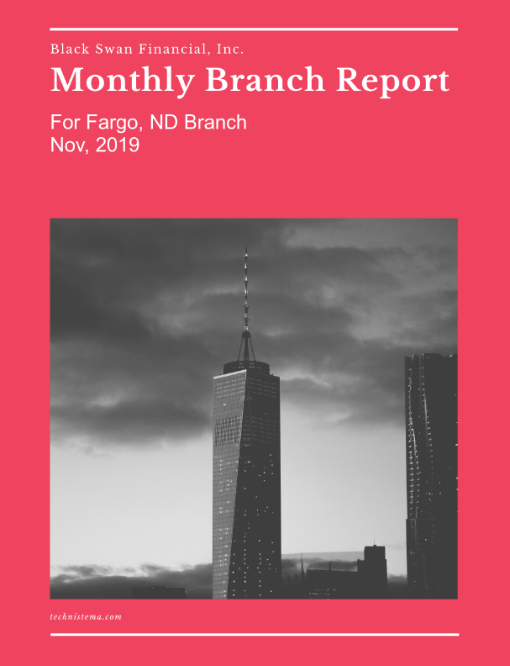

Slide 8
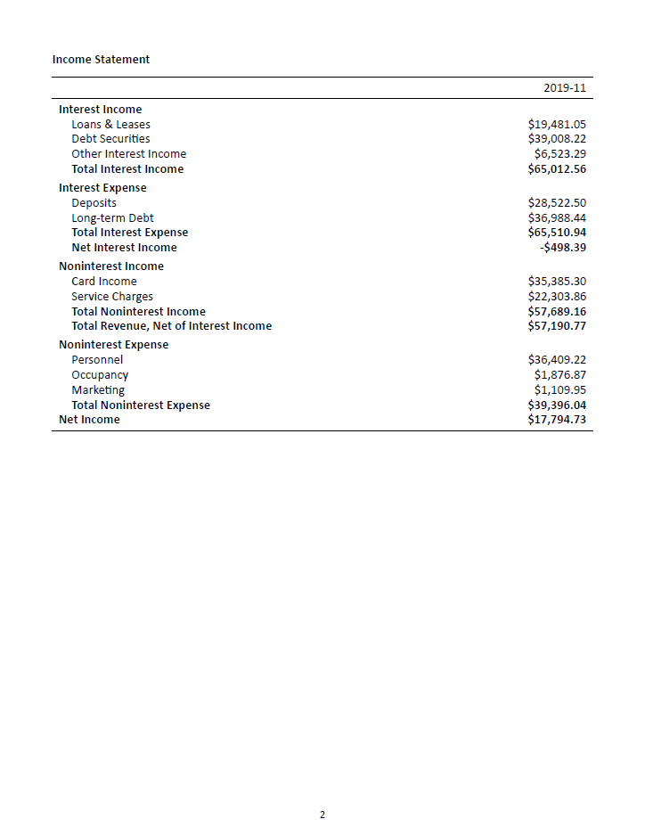

Slide 9
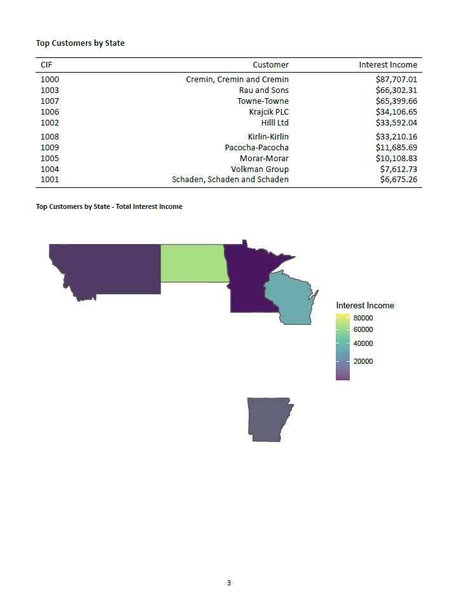

Slide 10
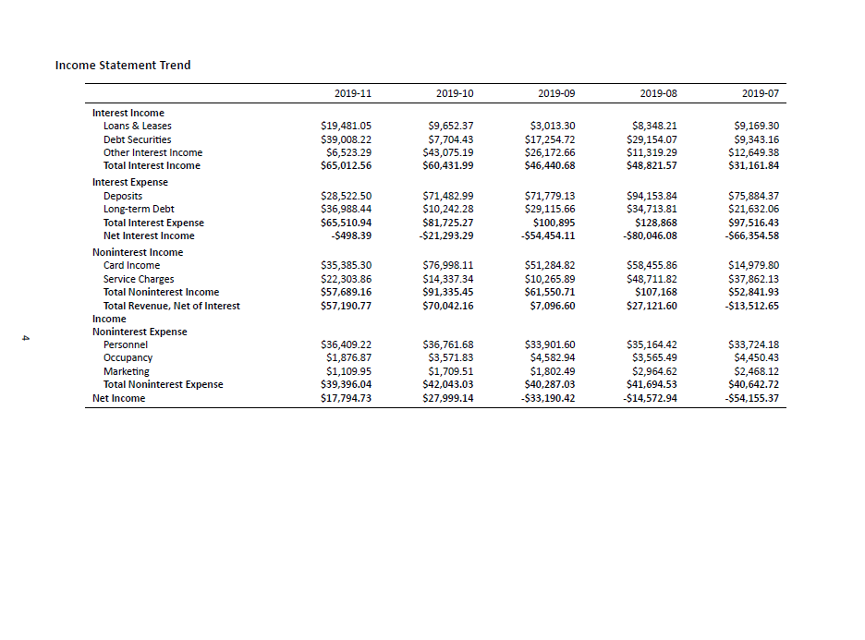

Slide 12
Use it:
Use my example repo to:
Fork the repo https://github.com/bradlindblad/pro_reports_talk
Pick off Excel reports
Make your own reporting easier
Automate the boring and error-prone stuff

